Slide 1
Lập trình trên Windows với Microsoft® .NET Giảng viên : Hồ Hoàn Kiếm

Slide 2

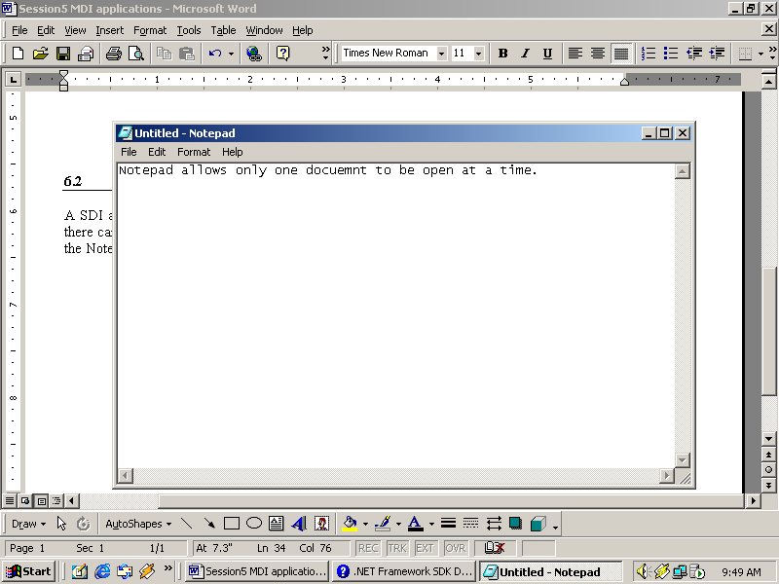
SDI Application
SDI (1)
Closed
New
Document
An SDI application can have only one active window at a time
Active Window

Slide 3
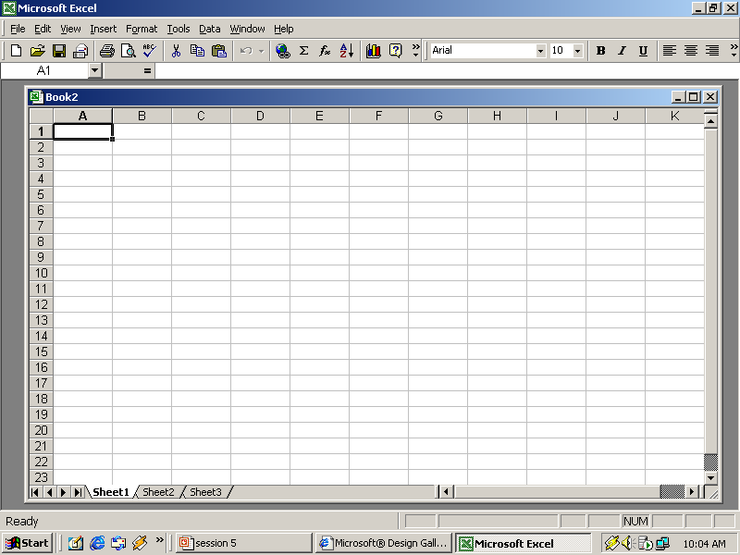
MDI Application
MDI (2)
Outer Window (or)
Parent Window
Inner Window (or)
Child Window

Slide 4
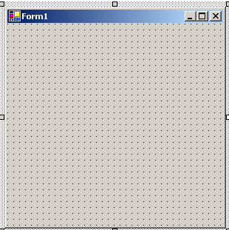
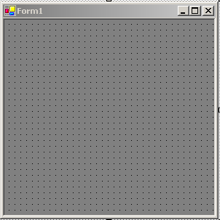
MDI Application
Designing an MDI application
IsMdiContainer
= true

Slide 5
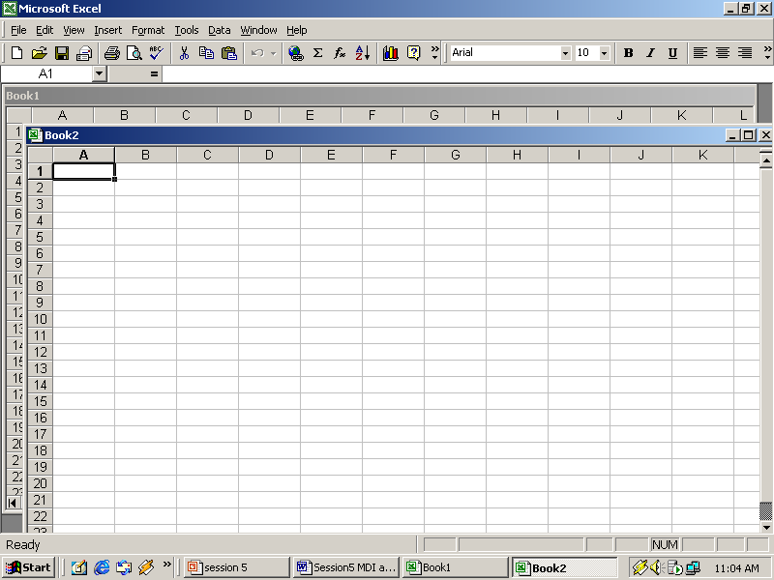
MDI Application
Activating and Deactivating Windows
Deactivate child window
Active child window

Slide 6
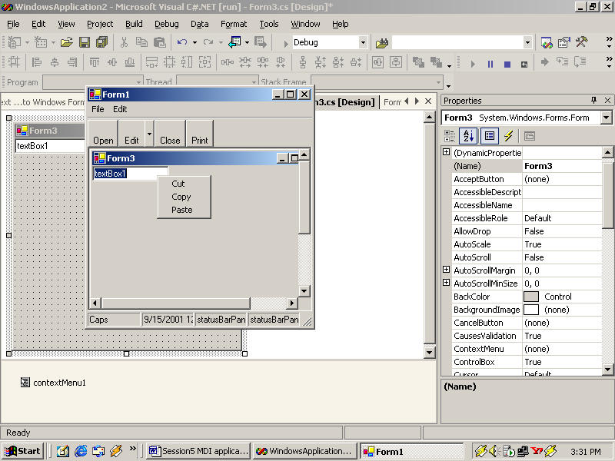
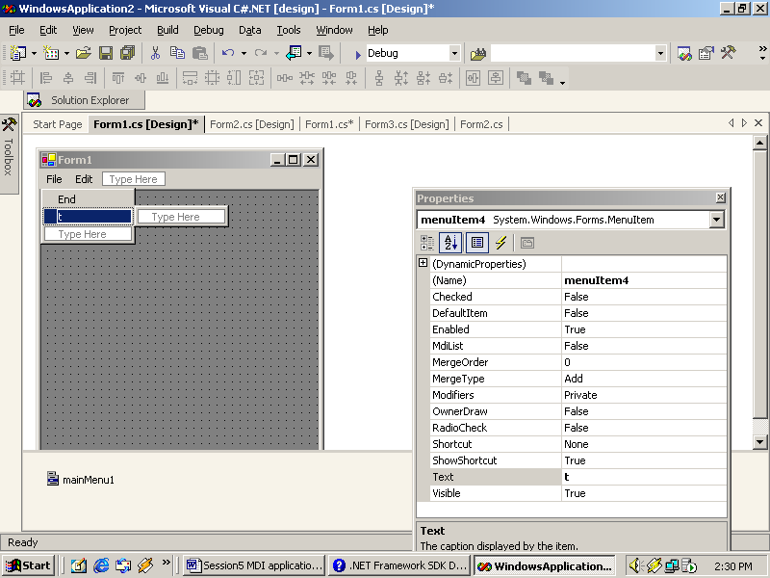
MDI Application
Types of Menu
ContextMenu
MainMenu
As with the control at runtime
As in MDI form during design

Slide 7
Main Menu
Displays a menu at runtime
MainMenu can be created in two ways:
1
Using the MainMenu control, and menu designer at design time
2
Creating an instance of the MainMenu class at runtime
MainMenu myMainMenu = new MainMenu();
this.Menu = myMainMenu;

Slide 8
Main Menu
MenuItems
PROPERTIES
METHODS
Parent
PerformClick
ShortCut
Text
PerformSelect
Index
ShowShortCut
EVENTS
Select
Click
Popup

Slide 9
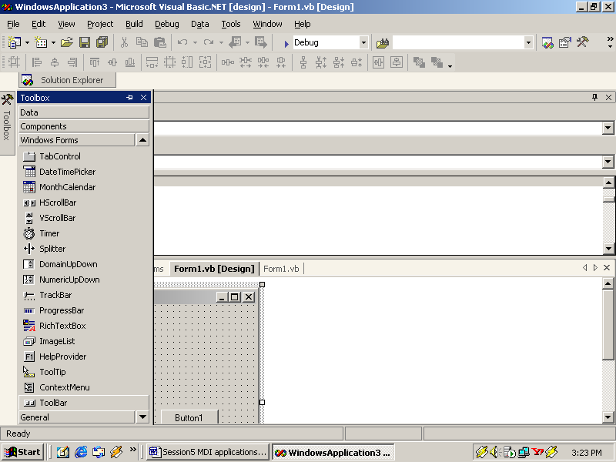
Context Menu
Context menus give users access to frequently used commands by clicking the right mouse button
Context menus are created with the help of the ContextMenu control

Slide 10
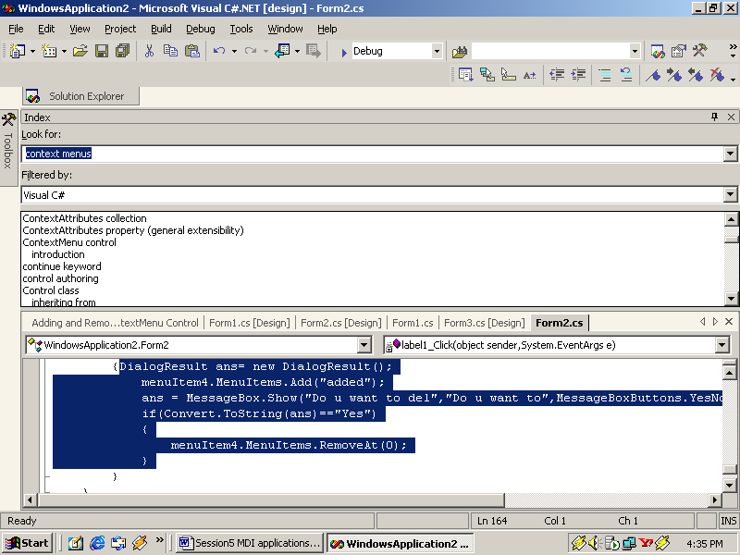
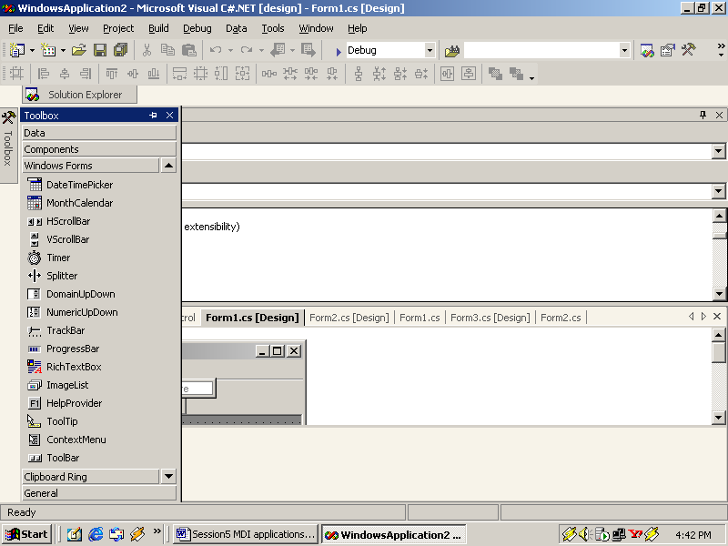
ToolBar
It is situated immediately below the menu bar
The buttons in a ToolBar are analogous to the items in a menu
ToolBar control icon as in ToolBox
Different button appearance options:
DropDownButton
Separator
ToggleButton

Slide 11
Form Level and Control Level Validations
Validate data in all the fields in the form
Enable and Disable controls based on user input
Main Events
KeyPress
KeyDown
KeyUp

Slide 12
Types of Errors
Errors | Description
Syntax Error | Occurs when we enter an incorrect line of code such as a mistake in typing a keyword, missing punctuation, or an incorrectly specified variable.
Run-time Error | Occurs when a command attempts to perform an invalid action.
Logic Error | Occurs when an application executes without syntax errors or run-time errors, but the results are not which were intended.

Slide 13
ErrorProvider Control
ErrorProvider control can be used to display an error icon when the user enters invalid data.
Properties | Methods
BlinkRate | GetError
BlinkStyle | SetError
ContainerControl
Icon

Slide 14

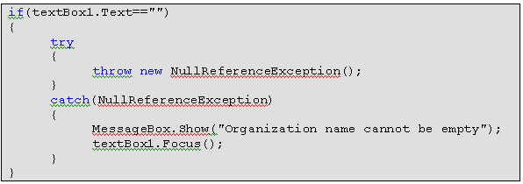
Exception Handling
Exceptions can be handled with the help of :
finally
try
catch
throw

